Slide 1
104 : INT_MAX
Shubham Shah | Data storage using IPFS and MongoDB.
Arjun Thakur | AI for similarity index
Shravani Nalbalwar | Frontend development
Sankalp Chordia | Solidity and metamask integration
Notes:
Frontend development
Solidity and metamask integration
Data storage using mongodb and MongoDB.
AI for similarity index

Slide 2
PROBLEM STATEMENT
Physical works of creation face conflict between the traditional art world elites and the aspiring creators.
Creators are deprived of expressing their works of creation due to financial prospects of modern art galleries charging 30-50 percent of commissions.
Art criticism and allowance being biased keeping people of certain criteria away from presenting their story to the audience.
A lack of transparency and authenticity leads to buyers enjoyers not reap complete justice to their price.
Only 10% of art school graduates make a living from their artwork

Slide 3

NFTy
Your own NFT marketplace

Slide 4
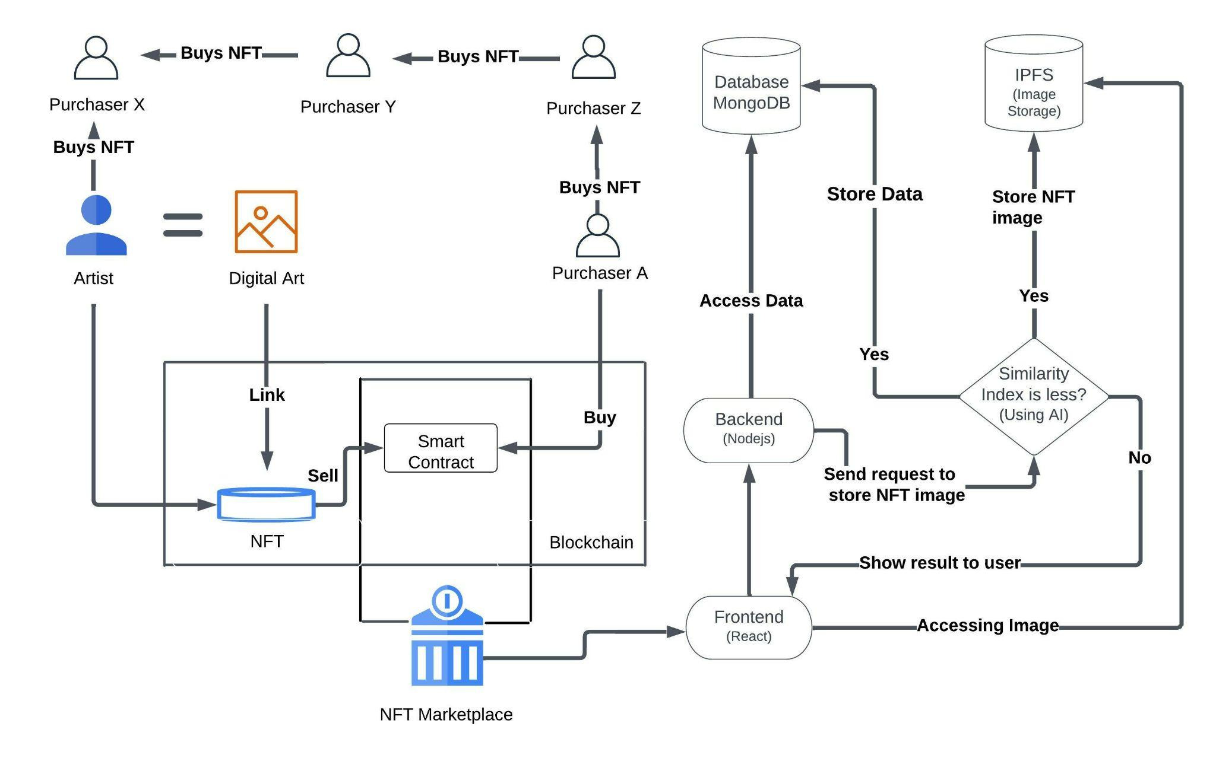
SOLUTION

Slide 5
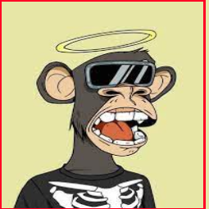
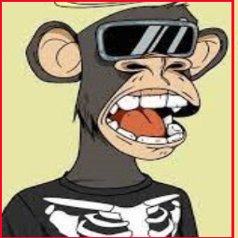
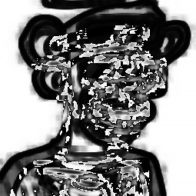

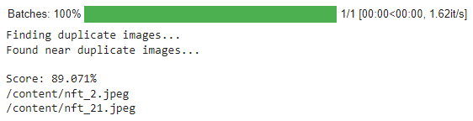
AI Model for similarity index
How NFTy benefits the users
Authentication of the original art.
Certify Uniqueness of the art.
Provide a tokenized network for sharing.
Record the proof of ownership.
Enable everyone who has a story to tell or an idea to share.
Multiple options to transfer ownership and rights

Slide 6
FUTURE SCOPE
TECH STACK
Solidity
Ethereum Network
Metamask
ERC721
Python
MongoDB
MoonPay Api
IPFS/ INFURA.io
Provide estimated selling prices from similar NFT collections that have been traded in past.
Include an elastic server for models to handle larger requests.
Have the editorial feature in multi linguistic model with search tag support.
Include MoonPay Api to facilitate Fiat currency transactions.

Slide 7
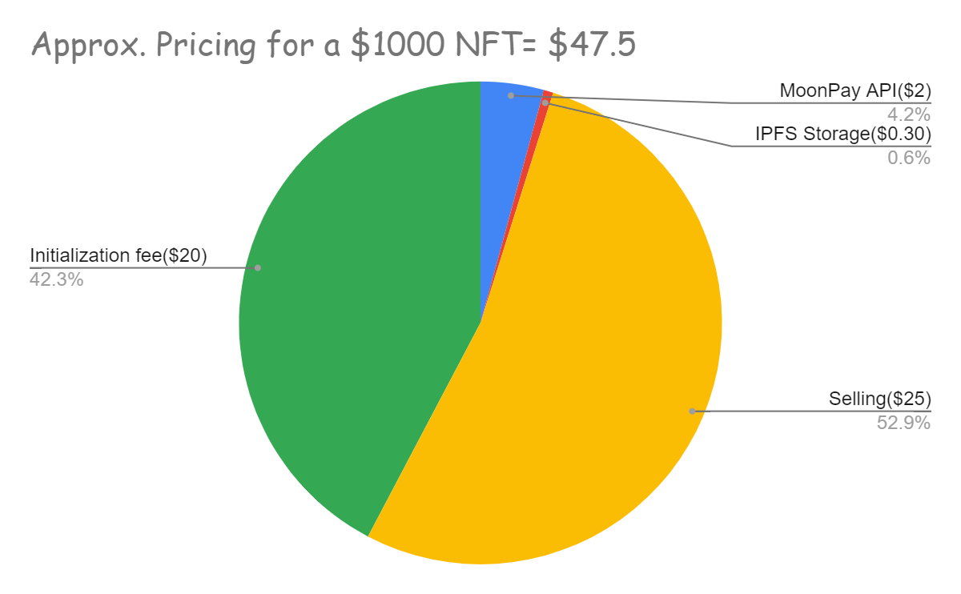
Pricing Model
WOW Factor
Allowing video and audio files as physical assets and NFTs
Copyright transfer through smart contracts
Educative measures
Enabling Fiat Currency
NFT Plagiarism (Similarity) Checking
No fee
Minting an nft
Modifying price while not in auction
Needs fee
Canceling an NFT listing
Canceling a bid

Slide 8
Learnings From The Hackathon
Challenges Faced During The Hackathon
Learning the importance of brainstorming and researching on an idea to lay right foundations.
Learning newer technologies in a shorter period of time while implementing them to serve the requirements.
Understanding importance of team coordination and task delegation.
MoonPay Api and blockchain gas fees limiting implementation.
Coordination between offline and online members of group.
Bottlenecks due to AI model deployed on free server.

Slide 9
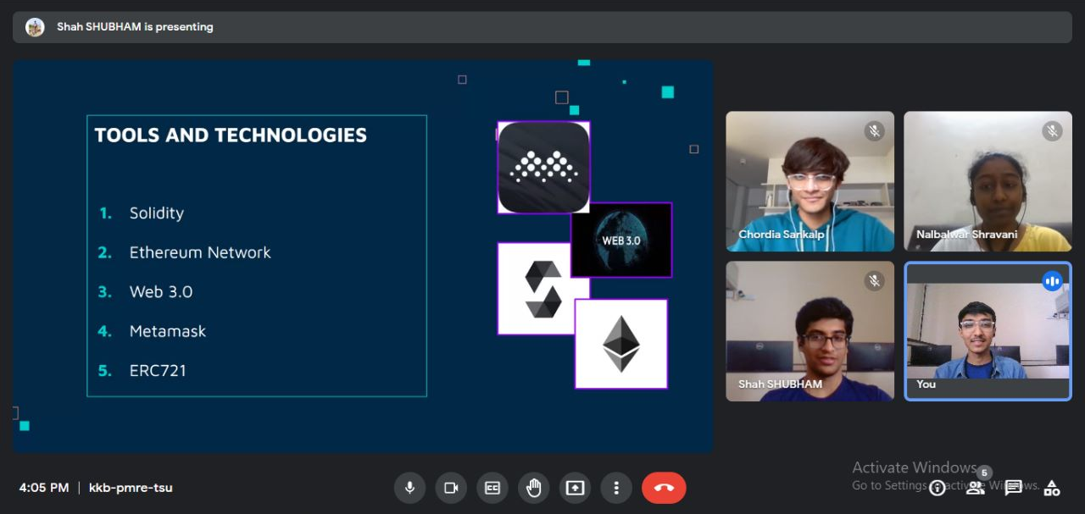
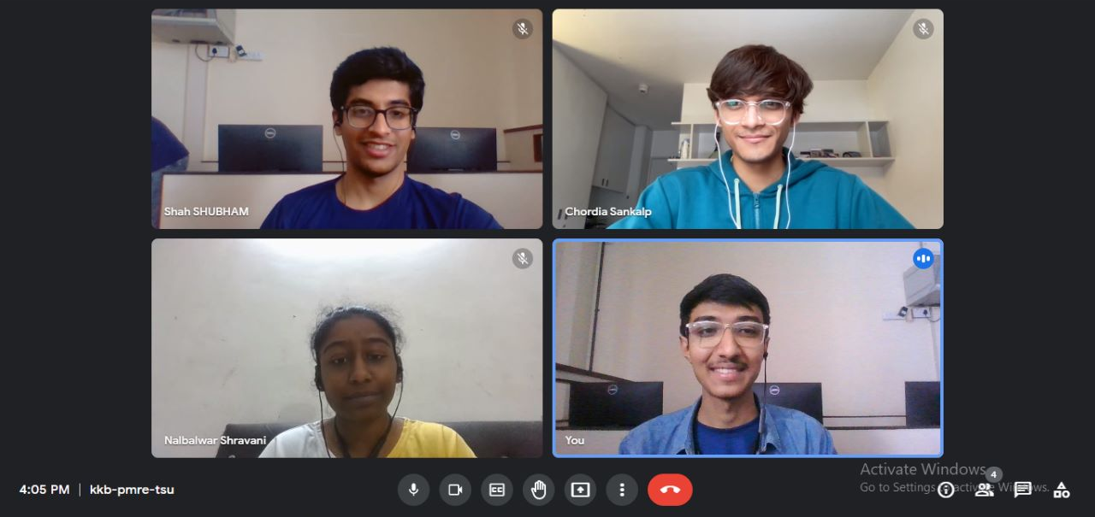
Memorable Captures

Slide 10
THANK YOU

